Slide 1

Computer Graphics Computer Animation Lecture-17
Tapasy Rabeya Senior Lecturer
Department of Computer Science and Engineering Daffodil International University, DIU

Slide 2
Computer Animation
Computer Animation is the process used for generating animated images using computer graphics.
Computer-assisted animation and computer-generated animation are two categories of computer animation

Slide 3
Animation Techniques
Animators have invented and used a variety of different animation techniques. Basically there are six animation technique which we would discuss one by one in this section.
Traditional Animation (frame by frame),
Key framing,
Procedural,
Behavioral,
Performance Based (Motion Capture),
Physically Based (Dynamics).

Slide 4
Traditional Animation (frame by frame)
Traditional animation is a technique in which each frame of the animation is drawn separately to create motion when played in sequence.
Each frame is drawn individually
Motion created by rapid display of frames
High artistic control
Time-consuming
Example: Hand-drawn cartoons

Slide 5
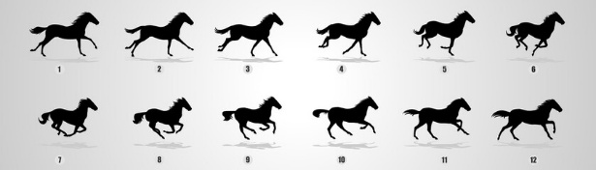
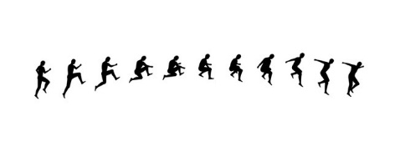
Traditional Animation (frame by frame)

Slide 6
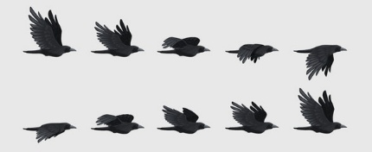
Traditional Animation (frame by frame)

Slide 7
Key-Frame Animation
Key-frame animation defines important frames (key frames), and the computer automatically generates the in-between frames (in-betweening).
Animator defines key frames
Computer generates in-between frames
Uses interpolation
Most common CG animation method
Example: Bouncing ball animation

Slide 8
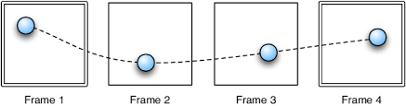
Key-Frame Animation

Slide 9
Procedural Animation
Procedural animation generates motion using mathematical rules, algorithms, or procedures instead of manually defining frames.
Motion generated using algorithms or rules
No manual frame definition
Efficient for repetitive motion
Example: Waves, fire, rotating objects

Slide 10
Procedural Animation

Slide 11
Behavioral Animation
Behavioral animation models autonomous behavior of objects based on rules and interaction with the environment.
Objects act as autonomous agents
Motion based on rules and goals
Interaction with environment
Example: Bird flocking, crowd movement

Slide 12
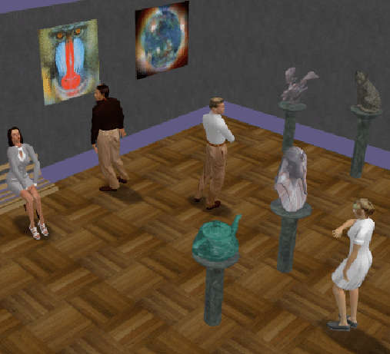
Behavioral Animation

Slide 13
Performance-Based Animation (Motion Capture)
Performance-based animation uses motion capture data recorded from a real human or animal to drive animation.
Real motion is captured using sensors
Data mapped to digital characters
Produces very realistic motion
Example: Character animation in films & games

Slide 14
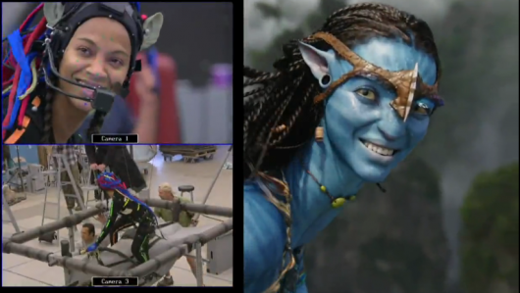
Performance-Based Animation (Motion Capture)

Slide 15
Physically-Based Animation (Dynamics)
Physically-based animation uses laws of physics to simulate realistic motion.
Motion based on laws of physics
Uses force, mass, gravity, collisions
Highly realistic but computationally heavy
Example: Falling objects, cloth simulation

Slide 16
DESIGN OF ANIMATION SEQUENCE
Steps for designing animation sequence
Storyboard Layout
Object Definitions
Key frame specifications
Generation of in-between frames

Slide 17
1.STORYBOARD LAYOUT
A storyboard is a plan, a way of figuring out the story of the film before you put in the enormous amount of work of the animation itself. Basically, it is the story of the movie drawn in pictures, very much like a comic strip.
Depending on the type of animation to be produced, the storyboard could be consist of a set of rough sketches or it could be a list of basis ideas for motion.

Slide 18
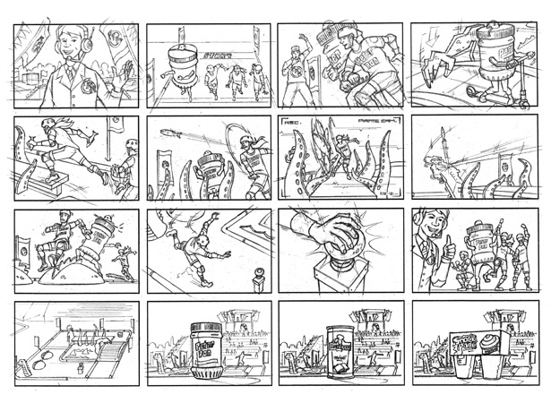
Continue……

Slide 19
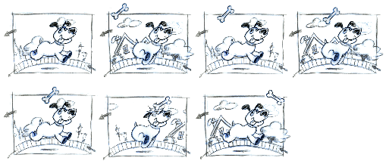
2.OBJECT DEFINITIONS
Each object participating in the action is given object definition, such as terms of basic shapes, such as polygons or splines.

Slide 20
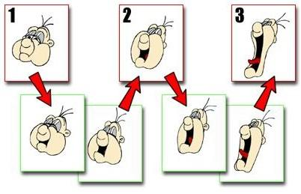
Frame
It is one of the many single photographic images in a motion picture. The individual frames are separated by frame lines. Normally, are needed for one second of film.

Slide 21
3. Key frame specifications
A keyframe is a frame where we define changes in animation. Every frame is a keyframe when we create frame by frame animation. When someone creates a 3D animation on a computer, they usually don’t specify the exact position of any given object on every single frame. They create keyframes.
Keyframes are important frames during which an object changes its size, direction, shape or other properties. The computer then figures out all the in-between frames and saves an extreme amount of time for the animator. The following illustrations depict the frames drawn by user and the frames generated by computer.

Slide 22
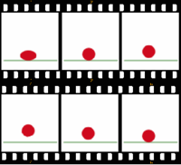
Continue……

Slide 23
4.Generation of in-between frames
It is a process of generating intermediate frames between 2 images to give appearance that the 1st image evolves smoothly into the second image. In-betweens are the drawing between the key frames which help to create the illusion of motion.
Film requires 24 frames per second and graphics terminals are refreshed at a rate of 30 to 60 frames per second.

Slide 24
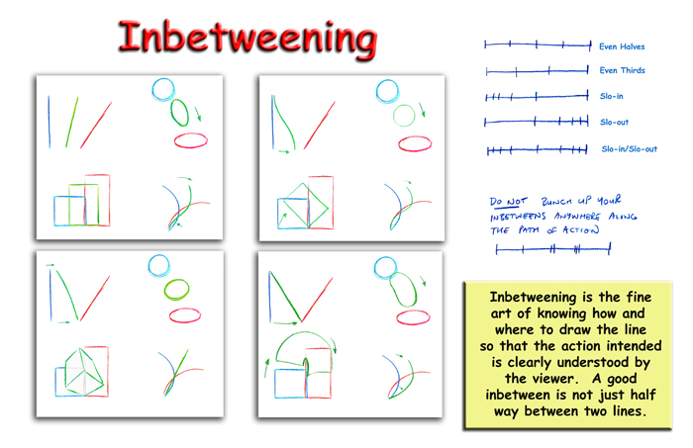
Continue……
In between frames work as intermediate frames between 2 key frames

